Slide 1


Introduction to AI – Day 1
Machine Learning Concepts, Classification
Shier Nee Saw, PhD
Department of Artificial Intelligence,
Faculty of Computer Science and Information Technology,
Universiti Malaya
sawsn@um.edu.my
https://shiernee.com

Slide 2

Machine Learning
Artificial Intelligence
A technique which enables machines to mimic human behaviour
Artificial Intelligence
Machine Learning
Machine Learning
Subset of AI technique which uses statistical methods to enable machines to improve with experience.
Deep Learning
Deep Learning
Subset of Machine Learning which make the computation of multi-layer neural network feasible
Notes:
I believe AI is quite a famous and common word right now. We keep hearing about Artificial intelligence, Machine learning and deep learning. What are those? AI is a technique which enables machines to mimic human behavior. Machine learning is a subset of AI in which it uses statistical methods to improve with experience. Random Forest, Support vector machine and clustering are some examples of machine learning. Deep learning, on the other hand, is more specialized in which the computation is designed in a multi-layered neural network architecture.

Slide 3
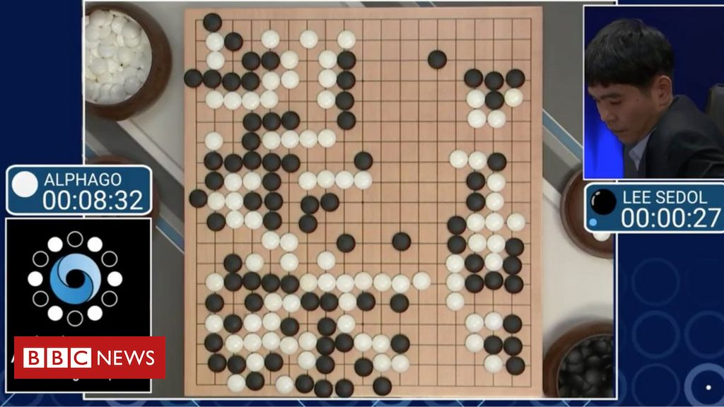
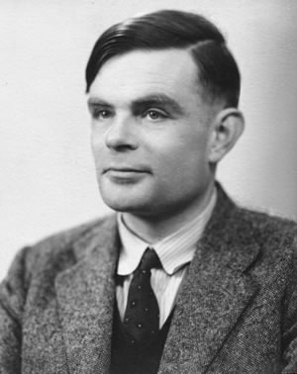
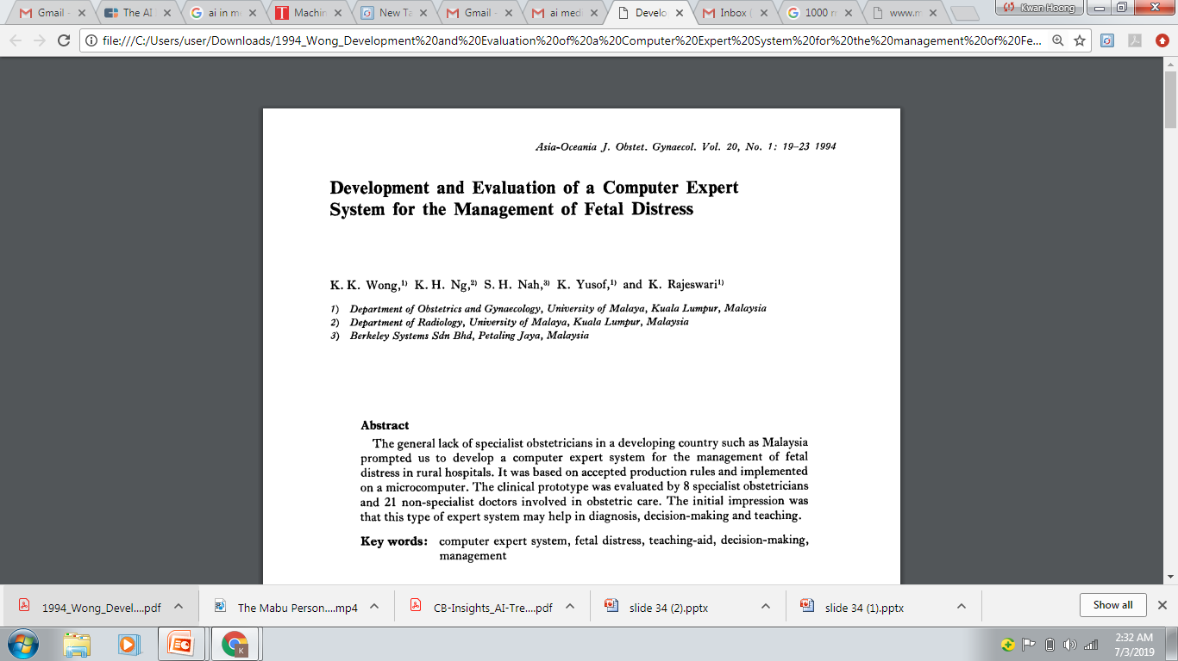
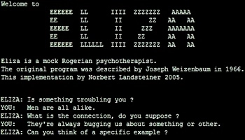
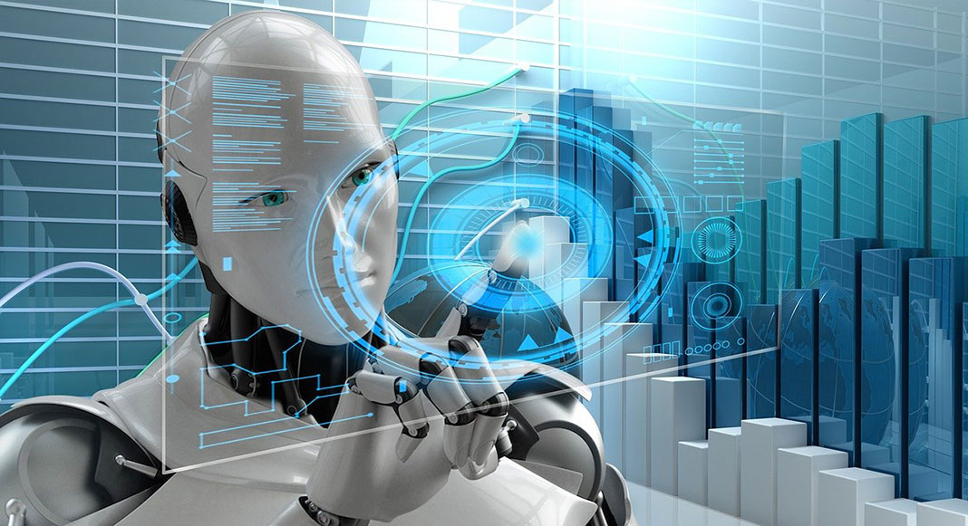
History
“Can machines think?”
Alan Turing introduce a method for machine intelligence
First AI Winter
Second AI Winter
Alpha Go defeated Lee Sedol, world champion of Go
https://www.bbc.com/news/technology-35785875
https://editions.covecollective.org/chronologies/alan-turing-%E2%80%9Ccomputing-machinery-and-intelligence%E2%80%9D-1950
1950
1966
1975
1980
1987
2016
Now
First Chatbot: ELIZA
Expert System
AI in everywhere
https://www.computerhope.com/jargon/e/eliza.htm
Notes:
The history of AI starts very early. In 1950s, at the dawn of computing, Alan Turing asked the question: "Can machines think?“ and he then introduced a method to test machine intelligence. This was at a time when the first general purpose computers had only just been built. In 1966, the first chatbox – ELIZA was built. Unfortunately, AI entered the first winter in 1975 where not much people were interested in such topics and no fundings were available to support this research. In 1980, it started to gain attraction again where expert system were built. In fact, UM also involved in this where they had developed a computer expert system to manage fetal distress. In 1987, AI entered the second winter again because the system was too difficult to maintain, to update and was unable to learn. Until 2016, Alpha GO was announced to defeat Lee Sedol, the world champion of GO. This shows the world how powerful a computer can be. And then, now AI in everywhere, be it in automotive, manufacturing or healthcare. Now, let’s move on to understand some of the dataset terminology.

Slide 4
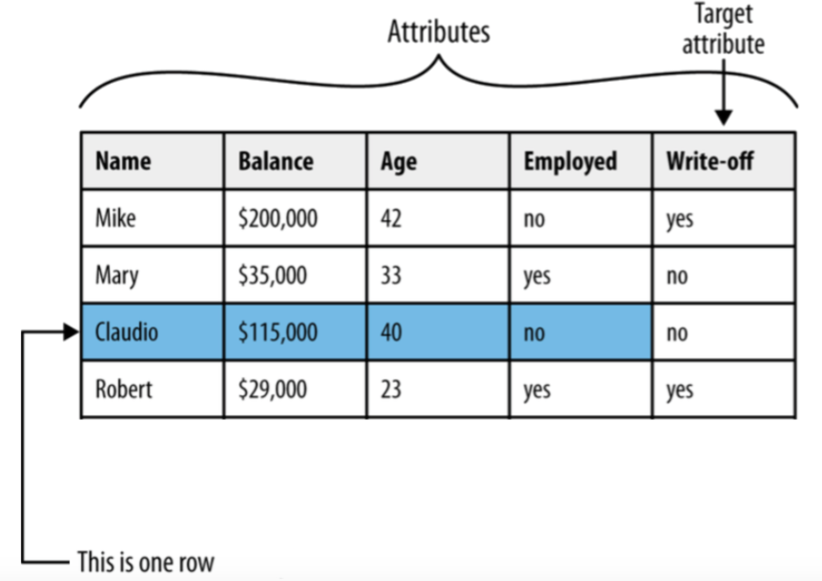
Dataset Terminology
Notes:
Here, you can see that we have a tabular data with four data / samples. We have 5 columns, name, balance, age, employed, write-off, all of these are called attributes. The target attribute will be the one we want the model to predict.

Slide 5
Dataset Terminology
The following terms are used interchangeably:
Row, observation, datapoint
Column, attribute, feature
Target attribute, target, label
A target attribute is one we are interested in predicting

Slide 6
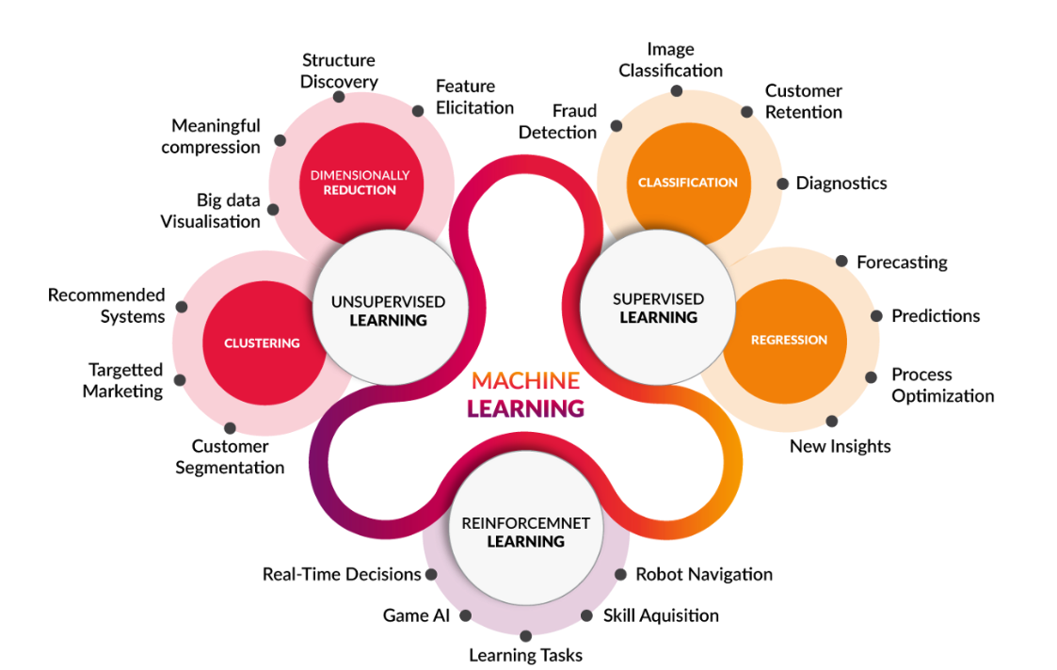
Machine Learning
https://medium.com/@yadavdeepika729/different-machine-learning-models-2387575e64cd
Notes:
There are three types of machine learning – unsupervised, supervised and reinforcement learning.

Slide 7
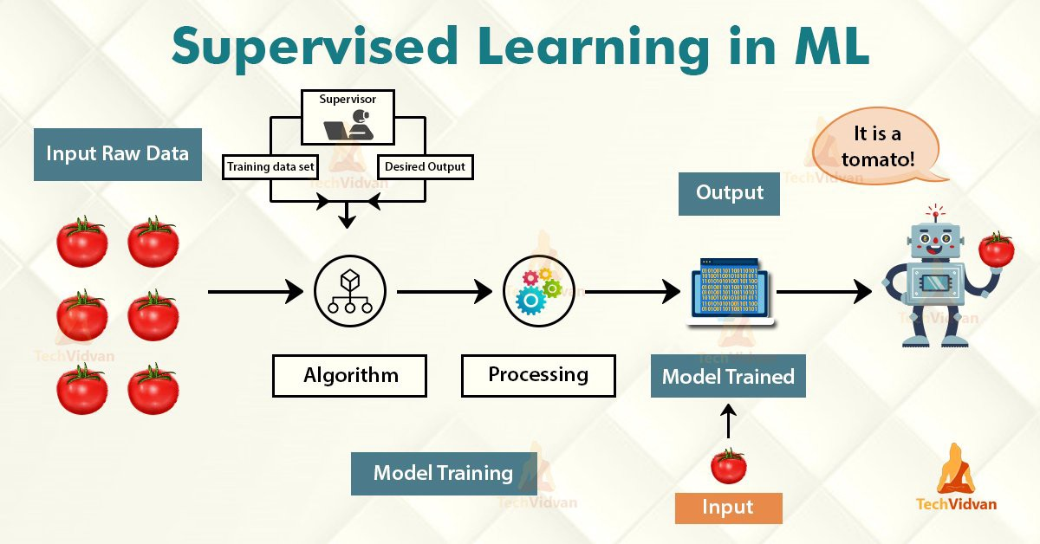
Machine Learning
Have Label
Learn from data pattern
https://medium.com/@yadavdeepika729/different-machine-learning-models-2387575e64cd
Notes:
In supervised learning, one important point is that the data have labelling. In this example, we want to train a model to recognise this item as tomato. So we pass in the raw data into the model, together with the labelling. These raw data will pass through processing and model training process. The model will learn the features such as perhaps red color, green leaves and round shape. In other words, the model will learn from the data pattern.

Slide 8
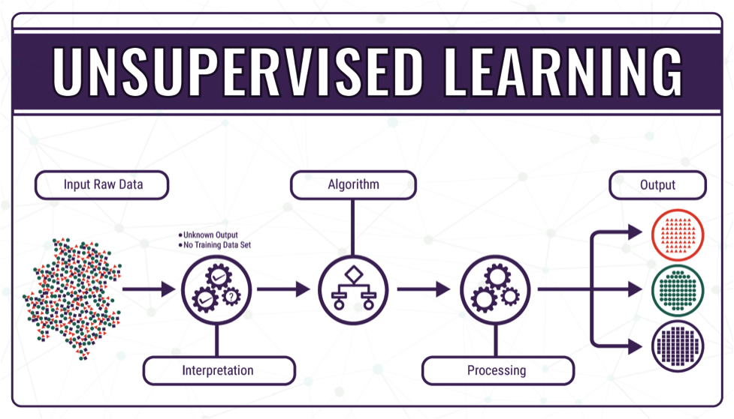
Machine Learning
Do not have label
Group similar data together
https://medium.com/@yadavdeepika729/different-machine-learning-models-2387575e64cd
Notes:
For unsupervised learning, the data do not have labelling, the idea of unsupervised learning is that it will group similar data together. For example, when we want to do customer segmentation, where we want to group customer based on similar characteristic. We do not know what’s the label, so this is called unsupervised learning.

Slide 9
Machine Learning
https://medium.com/@yadavdeepika729/different-machine-learning-models-2387575e64cd
Notes:
For today workshop, we focus on supervised learning, classification. Dr. Mustafa will be discussing the regression and clustering tomorrow.

Slide 10

Classification
Pause and think about some possible example on classification problem.
https://www.springboard.com/blog/data-science/regression-vs-classification/
Notes:
For classification, the prediction is categorical. For example, we want to predict whether tomorrow will be hot or cold. Sunny or rainy. Tall or short. Can you all share some possible examples in the chat on classification problems?

Slide 11
Classification
Classification is used when the target attribute is a category
Model is built based on target attributes of historical data
Examples: – Predicting churn – Predicting write-off

Slide 12
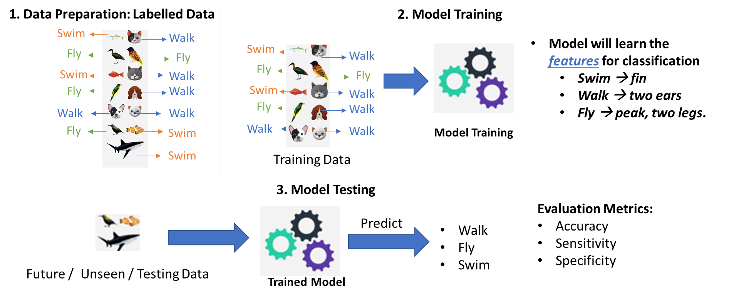
Classification – Developing ML model
Notes:
Now, we will go through the process on how to developing a AI model.

Slide 13
Classification – Developing ML model
Data Preparation
Data Splitting (Train/Test)
Model Training
Model Evaluation
Data | Feature1 | Feature2 | Prediction | Label
Data1 | 23 | 3 |  | Cold
Data2 | 12 | 51 |  | Hot
Data3 | 1 | 12 |  | Hot
… | … | … |  | …
DataN | 15 | 65 |  | Cold
Notes:
When we have a tabular data. It follows the same procedure. Instead of passing in images, we pass the model with features.

Slide 14
Classification – Developing ML model
Data Preparation
Data Splitting (Train/Test)
Model Training
Model Evaluation
Data | Feature1 | Feature2 | Prediction | Label
Data1 | 23 | 3 |  | Cold
Data2 | 12 | 51 |  | Hot
Data3 | 1 | 12 |  | Hot
… | … | … |  | …
DataN | 15 | 65 |  | Cold
70%
Training
30%
Test

Slide 15
Classification – Developing ML model
Data Preparation
Data Splitting (Train/Test)
Model Training
Model Evaluation
Use only training data to train the model
Data | Feature1 | Feature2 | Prediction | Label
Data1 | 23 | 3 |  | Cold
Data2 | 12 | 51 |  | Hot
Data3 | 1 | 12 |  | Hot
… | … | … |  | …
DataN | 15 | 65 |  | Cold
70%
Training
Notes:
70% of the data will be used for training. We can use various ML model for training. In this example, we choose decision tree

Slide 16
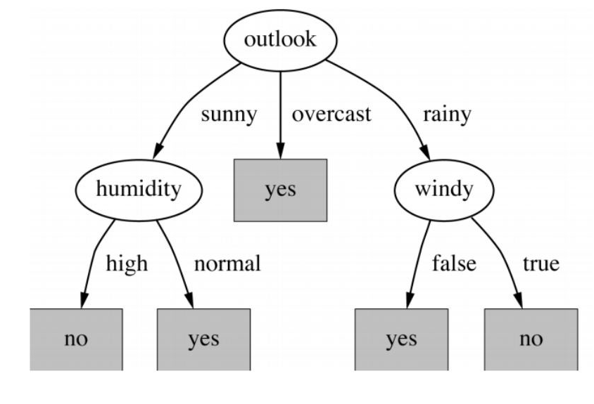
Classification – Developing ML model
Data Preparation
Data Splitting (Train/Test)
Model Training
Model Evaluation
Example of decision tree
Notes:
With the data, a decision tree, with multiple sets of rules, is constructed.

Slide 17
ML Model – Classifiers Evaluation Metrics
Data Preparation
Data Splitting (Train/Test)
Model Training
Model Evaluation
Use only testing data to evaluate the model
Data | Feature1 | Feature2 | Prediction | Label
Data1 | 23 | 3 | Cold | Cold
Data2 | 12 | 51 | Cold | Hot
Data3 | 1 | 12 | Hot | Hot
… | … | … | … | …
DataN | 15 | 65 | Hot | Cold
30%
Test
https://en.wikipedia.org/wiki/Confusion_matrix
Notes:
After we have the model trained, we will evaluate the model performance using the 30% testing data.

Slide 18
ML Model – Classifiers Evaluation Metrics
Data Preparation
Data Splitting (Train/Test)
Model Training
Model Evaluation
A perfect model should predict all testing data correctly → Accuracy = 100%
Data | Feature1 | Feature2 | Prediction | Label
Data1 | 23 | 3 | Cold | Cold
Data2 | 12 | 51 | Cold | Hot
Data3 | 1 | 12 | Hot | Hot
… | … | … | … | …
DataN | 15 | 65 | Hot | Cold
30%
Test
https://en.wikipedia.org/wiki/Confusion_matrix
Notes:
If the model has an accuracy of 100%, it is a perfect model where it predicted all datasets correctly.

Slide 19
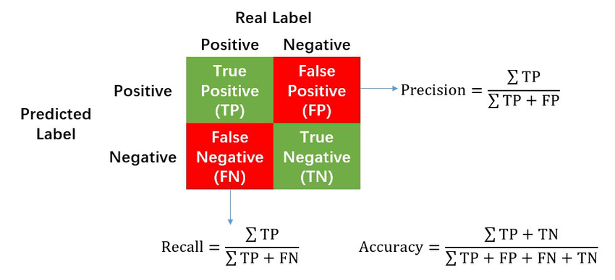
ML Model – Classifiers Evaluation Metrics
Data Preparation
Data Splitting (Train/Test)
Model Training
Model Evaluation
Confusion Matrix
https://en.wikipedia.org/wiki/Confusion_matrix
Notes:
There are also other evaluation metrics. The most commonly used metric in classification is the confusion matrix.

Slide 20
ML Model – Classifiers Evaluation Metrics
Accuracy: How many % of predicted cases are correct.
Precision: How many % of predicted positive cases are actually positive
Recall: How many % of positive cases did the classifier predict as positive?
F measure (F₁ or F-score): harmonic mean of precision and recall.
Perfect score is 1.0
Notes:
A perfect model has a score of 1.0 for all.

Slide 21
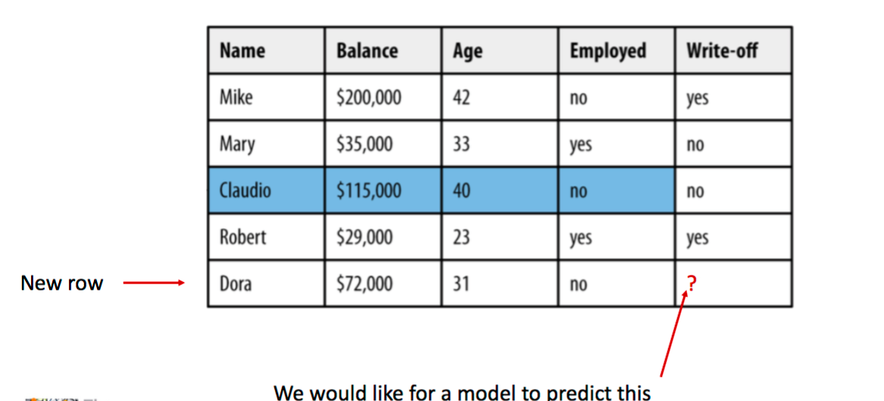
Classification – Example
Notes:
Now, let’s say after we finish the model training and evaluation, we want to predict a new case. Similarly, the features of the Dora will pass to the model.

Slide 22
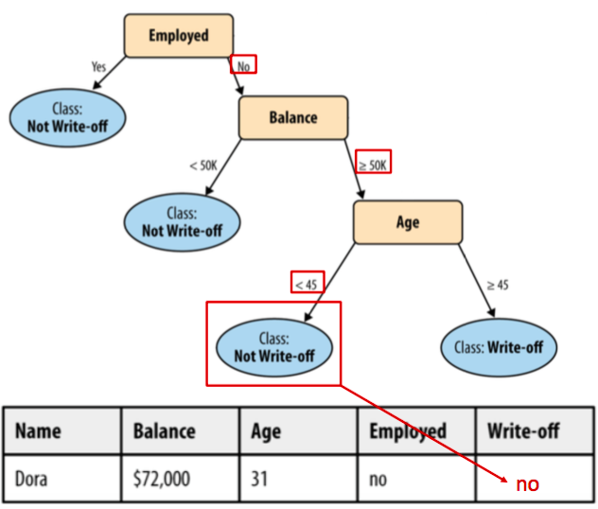
Classification – Decision Tree
Notes:
Given the trained model has this decision tree structure, based on the features from Dora, it follows the rules. First, Dora is unemployed. ….. So the prediction will be no write off. So far, any Q from the participants?

Slide 23
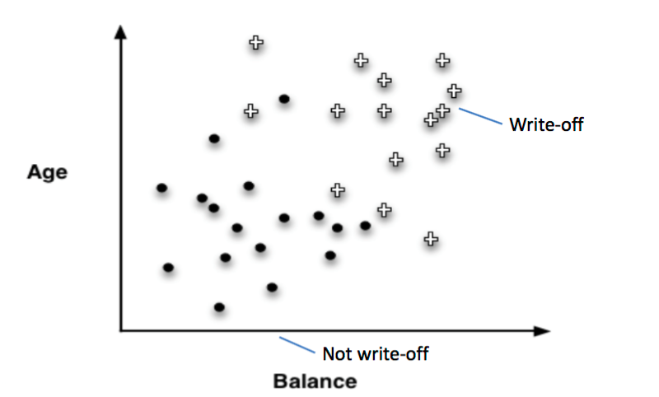
Classification – Results Visualization
Notes:
Now, let’s see if we only use two features – age and balanced. When we plot the data in 2D scatter plot, you can see that top right region mostly are write off, bottom left are not write off. Using the datasets shown here, we trained a decision tree.

Slide 24
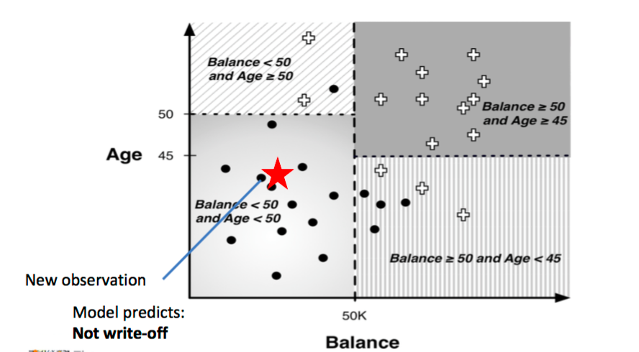
Classification – Results Visualization
Notes:
So here you can see that, the different sets of rules from decision trees results in different regions. For top right region, the rules are balance more than or equal to 50, age more than or equal to 45. When we have a new observation – the red color start, following the rules, it falls into bottom left. Thus it will be predicted as not write off because most of the labelling in this region is not write off. Similarly, if new observation falls into top right region, then it will predicted as write off. What if it falls into this region, what do you think the prediction is?

Slide 25
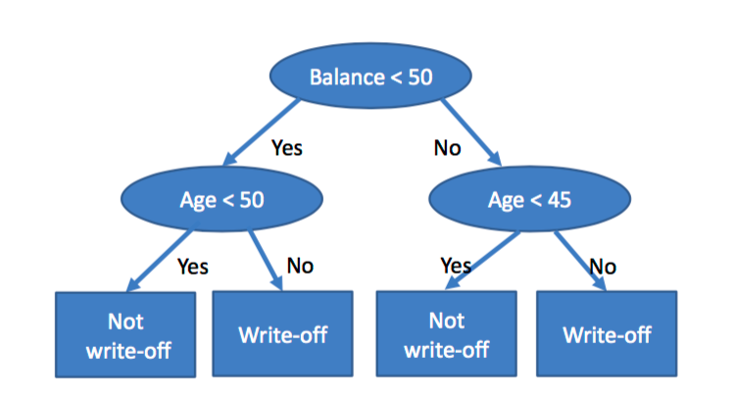
Corresponding Decision Tree
Notes:
So this will be the corresponding decision tree based on previous plots.

Slide 26
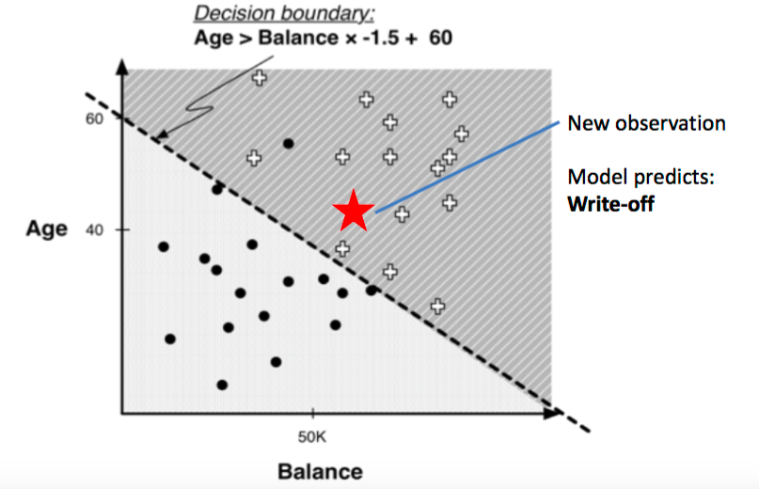
Results Visualization – Linear Classifier
Notes:
Aside from decision tree, we also have linear classifier where a linear decision boundary is built based on the data. This decision boundary can change based on the training data. Similarly, when the new observation falls into the top right region, then it will predicted as write off.

Slide 27
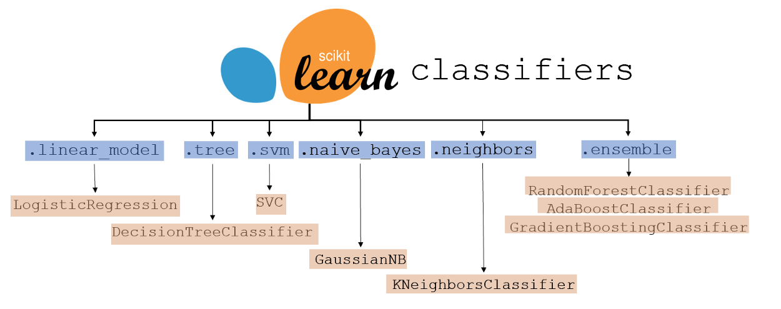
ML Model – Other types of classifiers
https://www.kdnuggets.com/2021/01/ultimate-scikit-learn-machine-learning-cheatsheet.html
Notes:
In classification, the most commonly used library is scikit learn where it has multiple classifiers, such as logistic regression, support vector machine.

Slide 28
Corresponding Code
Data Preparation
Data Splitting (Train/Test)
Model Training
Model Evaluation
pd.read_csv()
sklearn.model_selection.train_test_split()
model.fit()
model.predict()
Notes:
Here is the corresponding code.

Slide 29
Additional Reading
Your First Machine Learning Project in Python Step-By-Step https://machinelearningmastery.com/machine-learning-in-python-step-by-step/
4 Types of Classification Tasks in Machine Learning https://machinelearningmastery.com/types-of-classification-in-machine-learning/
Machine Learning Classifiers https://towardsdatascience.com/machine-learning-classifiers-a5cc4e1b0623
Save and Load Machine Learning Models in Python with scikit-learn https://machinelearningmastery.com/save-load-machine-learning-models-python-scikit-learn/

